Slide 1
A patient with vaginal/urethral Discharge
Dr. Indira Fonseka
Department of Medical Microbiology

Slide 2
Outline
Vaginal / urethral discharge
Aetiology
Clinical Features
Laboratory Diagnosis
Treatment

Slide 3
Vaginal discharge
Physiological discharge
Vaginal cells contain glycogen
Continuously shed
As cells autolyze and glycogen depolymerise to glucose
Serve as an energy source for lactobacilli
Lactobacilli metabolise glucose in to lactose
Normal vaginal pH around 3.6-4.0
Colourless and odorless

Slide 4
Vulvovaginitis
Abnormal Vaginal discharge
Change of colour, consistency, volume or odour
Symptoms
Itching,
soreness,
dysuria
pelvic pain,
intermenstrual bleeding

Slide 5
Causes for vaginal discharge
Infective causes (common)
Bacterial
Bacterial vaginosis
Neisseria gonorrhoeae
Chlamydia trachomatis
Fungal
Candidiasis
Parasite
Trichomoniasis (less common)
Herpes simplex (rare)

Slide 6
Causes for vaginal discharge cont..
Non infective causes (less common)
Inflammation due to allergy or irritation (Disinfectants, deodorants)
Retained foreign body Eg. Tampon
Tumours of vulva, vagina, cervix and endometirum
Cervical polyps
Atrophic vaginitis in post menopausal women

Slide 7
Vulvovaginal candidiasis
Caused by Candida albicans (80-90%), other yeasts (nonalbicans 20%)
Part of vaginal flora in asymptomatic women
Higher incidence among women
OCP users due to high oestrogen levels,
Uncontrolled DM
Immuno-suppressed patients (chemotherapy, transplantation, HIV)

Slide 8
Vulvovaginal candidiasis cont….
Symptoms
Vulval itching
Vulval soreness
Vaginal discharge
Superficial dyspareunia
External dysuria
Signs
Erythema
Fissuring
Discharge (may be curd-like, non-offensive)
Satellite lesions
Oedema

Slide 9
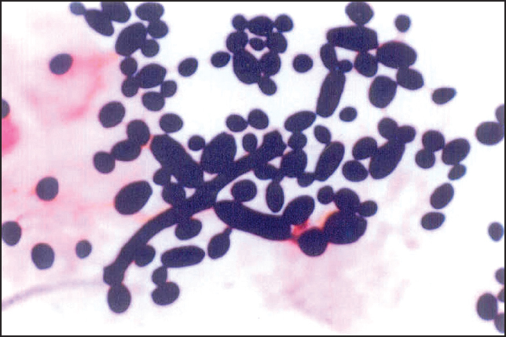
Diagnosis of Vulvovaginal candidiasis
Clinical
Laboratory
Gram stain – yeast cells/pseudohyphae

Slide 10
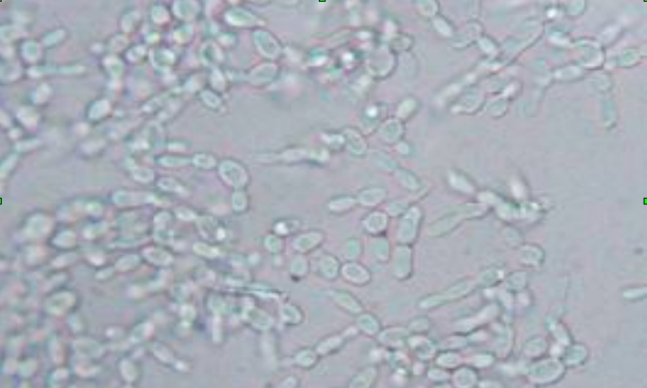
Diagnosis of Vulvovaginal candidiasis cont…
2. Wet mount with 10% KOH of vaginal discharge - look for yeast cells or pseudohyphae

Slide 11
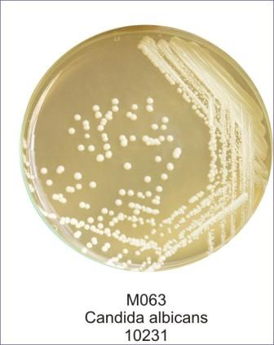
Diagnosis of Vulvovaginal candidiasis cont…
3. Culture of vaginal discharge: Sabouraud’s media ( in patients with recurrent candidiasis and if microscopic findings are inconclusive)
4. Vaginal fluid pH- normal

Slide 12
Treatment of Vulvovaginal candidiasis
Depends on complicated or uncomplicated infection

Slide 13
Uncomplicated | Complicated
Sporadic infection with Candida albicans | Infection with Candida non albicans
Mild to moderate disease | Severe disease
No history of recent infection | Recurrent infection (4 or more episodes per year)
No underlying illness: DM, HIV | Underlying immunosupression: DM,HIV, Malignancy, drugs
Treatment
Short course of vaginal or oral antifungal | Treat according to fungal culture
Topical /Vaginal preparations ( tablets, ointments, creams , pessary) Nystatin , micanazole, clotrimazole, tioconazole, terconazole Oral fluconazole 150 mg stat dose. Itraconazole 200mg bd x 1day | Need treatment for 14 days or more Prevent recurrent infection can use prophylaxis of oral fluconazole 150 mg per week

Slide 14
Bacterial Vaginosis (BV)
BV is the commonest cause of abnormal vaginal discharge in women of child bearing age.
BV is characterised by an overgrowth of predominantly anaerobic organisms in the vagina leading to replacement of lactobacilli.
Gardnerella vaginalis,
Prevotella species
Mycoplasma hominis
Mobiluncus species

Slide 15
Clinical features of BV
Symptoms
Spontaneous onset and remission of BV can occur.
Offensive fishy smelling vaginal discharge
Usually not associated with soreness itching or irritation
Many women (approximately 50%) are asymptomatic
Signs
Thin, homogeneous discharge, coating the walls of the vagina and vestibule
High risk of endometritis and salpingitis among women with BV

Slide 16
Diagnosis
Amsel criteria.
At least three of the four criteria should be present for the diagnosis to be confirmed.
(1) Thin, homogeneous and adherent (to vaginal walls) discharge
(2) Clue cells on microscopy of vaginal smear
(3) pH of vaginal fluid >4.5
(4) Release of a fishy odour on adding 10% KOH.

Slide 17
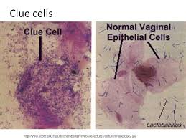
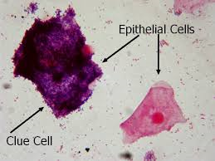
Wet mount
Increased number of pus cells
Clue cells
Vaginal epithelial cells studded with cocobacilli
Best appreciated at the edges of the cells

Slide 18
Positive Whiff test-
A characteristic "fishy" odor on wet mount.
By adding a small amount of potassium hydroxide to a microscopic slide containing the vaginal discharge, a characteristic fishy odor is considered a positive whiff test and is suggestive of bacterial vaginosis.

Slide 19
Complications
In pregnancy BV is associated with
late miscarriage,
preterm premature rupture of membranes,
preterm birth
postpartum endometritis.
The prevalence of BV is high in women with pelvic inflammatory disease (PID).
In some instances BV may be associated with NGU in male partners.

Slide 20
Treatment of BV
Treatment for BV is indicated for symptomatic women.
Recommended treatments
Metronidazole 400 mg orally twice daily for 5-7 days
or
Metronidazole 2 g orally single dose
Alternative treatments
Intravaginal metronidazole gel (0.75%) once daily for 5 days
or
Clindamycin 300 mg orally twice daily for 7 days
or
Tinidazole 2 G orally single dose

Slide 21
Trichomoniasis
Caused by protozoan Trichomonas vaginalis
Not normally present in vagina
Exogenous STI
Purulent discharge with vulvar irritation
Dysuria
Dyspareunia
Abnormal odor

Slide 22
Diagnosis
Signs
Vulvar and vaginal erythema,
Purulent discharge
Vaginal pH > 4.5
Wet smear- pus cells and motile flagellated trichomonads
Culture
Non culture methods
Rapid diagnostics
NAAT

Slide 23
Treatment
DOC – Metranidazole 500mg bd for7 days
Tinidazole
Need to treat partners

Slide 24
Cervicitis
Infectious Cervicitis
Non -infectious Cervicitis

Slide 25
Infectious Cervicitis
Caused by STD
Neisseria gonorrhoeae
Chlamydia trachomatis
Mycoplasma genitalium
Clinical features
Abnormal vaginal discharge
Intermenstrual vaginal bleeding
Post coital bleeding
Lower abdominal pain- can associated with urethritis, endometritis or salpingitis

Slide 26
Signs
Vulva and vaginal mucosa usually normal
Purulent or mucopurulent endocervical exudate
Sustained endocervical bleeding
Cervical oedema and erythaema

Slide 27
Laboratory Diagnosis of gonococcal infection
Collection of Specimens
Sterile cotton swabs should be used
Endocervix
The use of antiseptics, analgesics and lubricants should be avoided when collecting specimens.
Use a vaginal speculum, clean the ecto-ocervix with a large cotton swab. Insert the sterile cotton swab about 2cm into the cervical canal.
Rotate and move the swab gently from side to side for 5-10 seconds to allow absorption of the exudate.

Slide 28
Laboratory Diagnosis of gonococcal infection
Vaginal specimens are recommended for prepubertal girls without speculum

Slide 29
Laboratory Diagnosis of gonococcal infection
Smear for microscopy should be made.
To obtain a thin homogenous film, roll the swab on to a clean slide, and allow the smear to air dry.
Culture
specimens are inoculated directly on to a culture medium in the examination room.
Roll the swab containing the specimen over a small area of the surface of the culture plate.
Inoculated plate should be sent to the laboratory immediately for further streaking and incubation

Slide 30
Laboratory Diagnosis of gonococcal infection
Transport of Specimens
If culture facilities are not available, the swabs should be inserted into a transport medium (Amies) and transported at room temperature, to reach the laboratory within 24-48 hours.

Slide 31
Microscopy
Pus cells >30/ high power field in a cervical smear support the diagnosis of cervicitis.
N. gonorrhoeae- Gram stain intracellular Gram negative diplococci
Culture
considered the gold standard for the diagnosis of infection with N. gonorrhoeae
sensitive (>95%)
Selective culture media such as Thayer Martin (TM), modified Thayer Martin (MTM) and New York City(NYC) containing antimicrobials are often used for routine isolation of gonococci.
NAAT
can be performed on traditional swab specimens collected from the urethra and cervix.

Slide 32
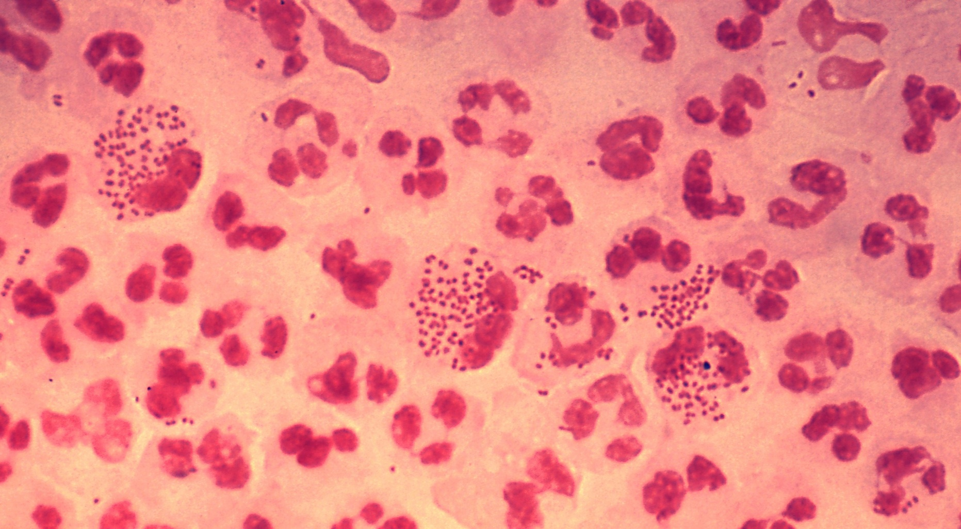
N. gonorrhoeae Gram stain of vaginal pus - intracellular Gram negative diplococci extracellular Gram negative diplococci

Slide 33
Laboratory Diagnosis of Chlamydia trachomatis
Specimen collection and transport
Viable chlamydial organisms are found within urethral, cervical, and rectal epithelial cells, but not in exudate or pus.
Cervical swab:
Clean the cervical
Insert the sterile cotton swab about 2cm into the cervical canal.
Rotate and move the swab gently from side to side for 15-30 seconds to obtain an adequate number of cells.
Remove swab, taking care not to contaminate it with material from the vaginal walls and place in transport medium
Urethral swab in men:
Insert a swab 2 to 3 cm into the urethra and rotate, making sure the swab is in contact with the urethral wall to obtain an adequate number of cells.
Remove the swab and place it in transport medium.

Slide 34
Laboratory Diagnosis of Chlamydia trachomatis cont…
Laboratory tests to diagnose Chlamydia:
Antigen detection by ELISA
Culture
Direct Immunofluorescence
NAAT

Slide 35
Complications
Scarring and fibrosis of fallopian tubes leads to
Infertility
ectopic pregnancy
Pelvic inflammatory disease

Slide 36
Treatment of cervicitis
Anticlamydial drugs
Doxycycline 100 mg orally twice a day for 7 days
Azithromycin 1 g orally in a single dose
Tetracycline
Erythromycin
N. gonorrhoeae - uncomplicated anogenital infection in adults:
Cefuroxime axetil 1g orally single dose
Ceftriaxone 250mg IM as a single dose
Cefixime 400mg orally as a single dose
Spectinomycin 2g IM as a single dose

Slide 37
Non-infectious cervicitis
Inflammation in an ectropion
Not associated with urethritis, endometritis or salpingitis

Slide 38
Urethritis
Urethritis or inflammation of the urethra, is a multifactorial condition which can be sexually acquired.
Urethral inflammation can occur without a known pathogen being isolated

Slide 39
Aetiology
Gonococcal urethritis
Non-gonococcal urethritis (NGU)
C. trachomatis 11-43%
M. genitalium 9-25%
Adenoviruses 2-4%
T. vaginalis 1-20%
Herpes simplex virus 2-3%
N. meningitidis
Haemophilus spp
Candida spp

Slide 40
Clinical features
Symptoms
May be asymptomatic
Urthral discharge
Dysuria
Urethral irritation
Signs
Urethral discharge.
(This may have not been noticed by the patient or may only be present on urethral massage.)
Erythema and oedema of urethral meatus (Meatitis)
Normal examination

Slide 41
Complications
• Epididymo-orchitis
Can present with unilateral scrotal pain, swelling and tenderness
• Sexually acquired reactive arthritis(Arthritis with or soon after NGU)
Reiter’s syndrome
• Prostatitis

Slide 42
Specimen collection
Use a sterile cotton swab
Urethra
If discharge is evident collect directly on to a swab. If not, milk the urethra to evacuate exudate.
Still if no discharge collect urethral specimens, 4 hours after the patient has passed urine , by inserting a thin swab 2-3 cm in to the urethra and gently rotating the swab for 5-10 seconds to allow absorption of the exudates.

Slide 43
Specimen collection cont..
If urethritis is not detected in symptomatic patients, - early morning sample - EMS.
A mid-stream sample of urine (MSU) should be taken if a urinary tract infection is suspected.

Slide 44
Investigation and diagnosis
confirmed by demonstrating polymorpho-nuclear leucocytes (PMNL) in the anterior urethra.
(i) A Gram stained urethral smear containing 5 or more PMNL per high-power (x1000)
and/or
(ii) A Gram stained preparation from a centrifuged sample of a first passed urine (FPU) specimen, containing 10 or more PMNL per high-power (x1000)

Slide 45
Treatment
Treatment should be initiated as soon as the diagnosis is made and without waiting for the results of tests for chlamydia and cultures for N. gonorrhoeae.
Recommended treatments
Doxycycline 100 mg twice a day for 7 days or
Azithromycin 1g orally in a single dose
Alternative treatments
Erythromycin 500mg twice daily for 14 daysor
Ofloxacin 200mg twice a day or 400mg once a day for 7 days

Slide 46
Questions?

Slide 47
Thank you

